Slide 1
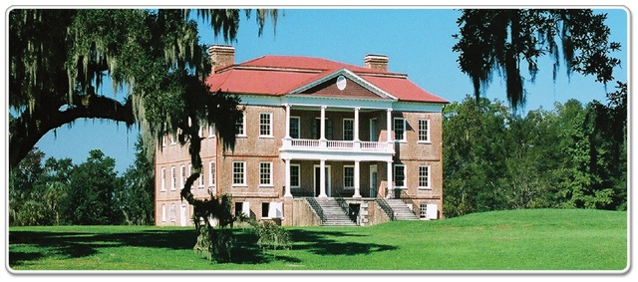
The Antebellum South
via the Building Blocks of History
This power point presentation is for educational purposes. It may contain copyrighted material. Please do not post, redistribute or copy without the permission of the author or Dr. Kevin Brady at the American Institute for History Education.

Slide 2
The Building Blocks Structure
Contextualization and Interpretation
There are four blocks, and if these building blocks get out of order or out of alignment then historical understanding suffers
Building Conceptual Knowledge
Breaking Down into Digestible Parts
Essential Questioning

Slide 3
Implementation
Begin with an essential question (or a couple) to help frame the lesson
Begin the process of “chunking” the information
Using the age-old Economic, Social, and Political pieces of the puzzle
Use discussion of the various “chunks” build conceptual knowledge and understanding
Finish by answering the essential question to establish context and reinforce interpretation

Slide 4
Why Use this Method?
Helps students see history in a focused and organized fashion rather than something that can be overwhelming in its entirety
Unless teachers consciously identify the essential understandings related to a topic, they focus on fact-based content as the endpoint in instruction, and the conceptual level of understanding usually is not addressed.
Utilizing the structured Building Blocks approach allows teachers to help students build that elusive conceptual understanding, contextualization, and interpretation.

Slide 5
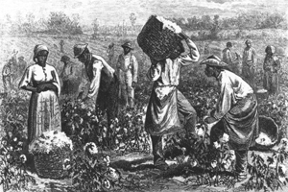
Let’s Begin!
The fun part

Slide 6
General Characteristics of the Antebellum South
Primarily agricultural
Economic power shifting from “upper south” to the “lower south”
Cotton has become KING
Industrialization is slow and fitful
Financial system is almost colonial in nature
Very poor transportation system

Slide 7
The Myth of the South
Two very common southern myths:
The legend of the southern cavalier
Drinking mint juleps
Living in palatial homes on manicured plantations
Perpetually white cotton fields
Well mannered and happy slaves
A pattern of corrupt opulence based on exploitation
Arrogant
Selling slaves down the river
Miscegenation
This leaves out the vast majority of southern whites.

Slide 8
We are going to look as Economics and Society today, Politics will fit better in the next colloquia.

Slide 9
Antebellum Southern Economy
“Thoughts, words, ideas, concepts, life itself, grew from the soil”
– Frank Owsley (southern defender)

Slide 10
Essential Question
What characteristics of the southern economy played such a powerful role in the development of the often mythical antebellum south?

Slide 11
Agrarianism
From the very beginning, the southern area of America was rooted in farming
The development of cash-crop farming further embedded agriculture as the bulwark of the South
The need for vast quantities of cheap labor created a unique twist to southern agriculture
Southern agrarianism fostered a unique sense of honor and view of the nation

Slide 12
Agricultural Factors
Split into two parts
Causal effects of geography and environment
Causal effects of human actions

Slide 13
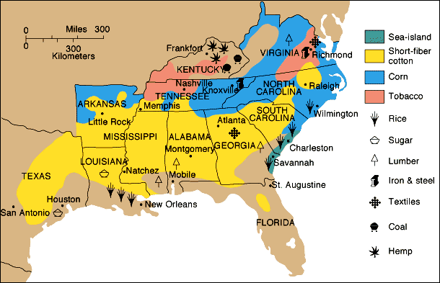
Southern Agriculture

Slide 14
Johnny Come Lately
Tobacco was the first cash crop and was a mainstay in NC, VA, and MD
Indigo had been a big deal, but declined after the Am-Rev
Rice growing was big in the small strips on the SC coast (extended to NC and GA)
Sugar was very important to the Gulf coast
Cotton boomed long after these crops

Slide 15
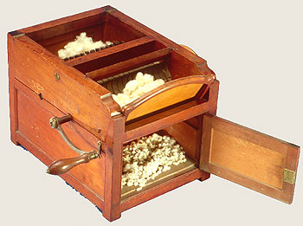
The Cotton Gin
Four major effects
Short staple cotton becomes viable
Slavery is reinvigorated to produce cotton
Economies of the North and South become intertwined
Cotton becomes KING

Slide 16
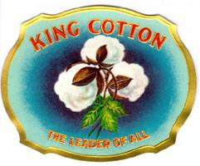
King Cotton
After 1840 cotton comprised ½ of all American exports
Over ½ of all cotton in the world was produced in the South
Britain was dependent on cotton
20% of Britain’s population was involved in the textile industry
¾ of Britain’s raw cotton came from the South

Slide 17
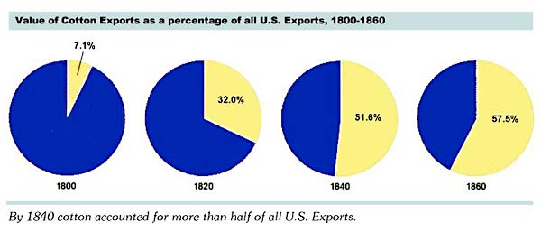
Cotton as % of exports

Slide 18
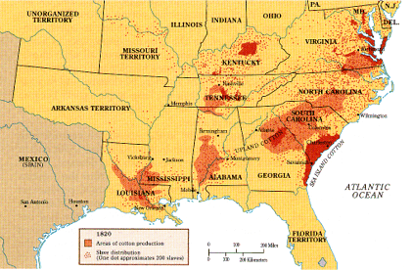
Cotton in 1820’s

Slide 19
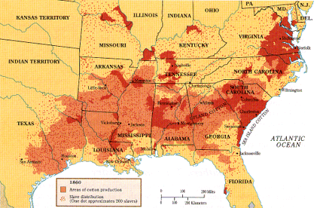
Eve of Civil War

Slide 20
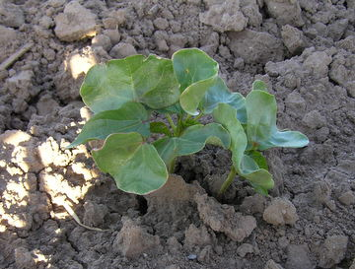
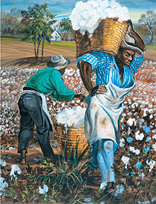
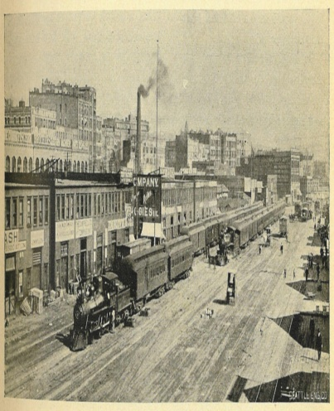
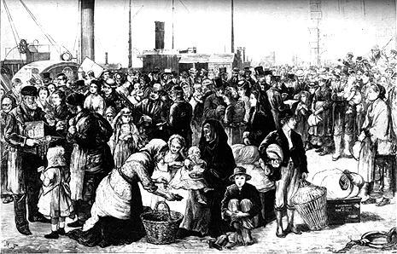
Southern Economic Weaknesses
Land intensive, depleting, and monopolistic
Huge capital investment in land and labor
Discouraged economic diversification
Discouraged immigration to the south

Slide 21
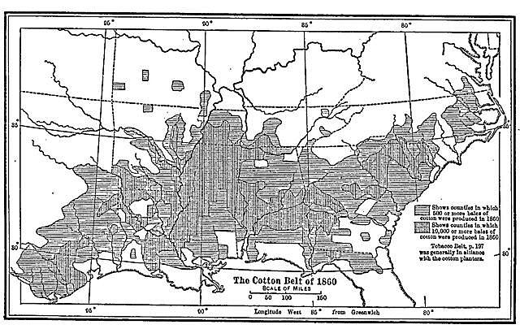
Cotton = Weak Econ
Land butchery (soil depletion) leads to a “movement” by cotton plantations
Reliant on the boom and bust of the cotton market
Capital is tied up in slaves, land, and “the crop”

Slide 22
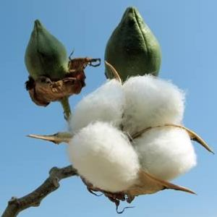
Cotton = Monopolistic
Surpluses = price drops per bale
Small farmers are driven out as prices fall
Requires massive investment in land and labor
Up to $1200 per field hand
Slaves subject to the vagaries of life (sickness, disease, accidents)

Slide 23
Cotton = no diversity
The majority of the economy was dependent on the vagaries of the cotton market
No insurance in case of blight, surpluses, poor growing weather, etc
Discouraged manufacturing or any industrialization

Slide 24
“Other” Farming
Fed self from own fields
Most yeomen farmed the same way as those in the north and northwest
Corn was everywhere, but used for local consumption rather than sold
Livestock feed, human food
Livestock – cows(50%), pigs (60%), mules (90%), sheep (33%)

Slide 25
Why no industry?
South was historically agrarian and that created a sort of economic inertia that kept a stasis
Manufacturing required labor
Working for another man in a factory was considered next to slavery
Capital was tied up in slaves and land that could have been used in industry
Only the far-seeing thought to use slaves as industrial labor

Slide 26
Little Immigration
Irish immigrants were usually poor and couldn’t compete with slave labor
Germans were generally anti-slavery and desired to settle on small farms
South was very balkanized by the mid 19th century
By 1860 just over 4% of the southern population was foreign born, rest of US was over 18%

Slide 27
Conclusion
The southern economy was based on agriculture, and agriculture was based on slavery, and low tariffs, and cheap land. The reliance on agriculture (specifically cotton) discouraged economic diversity, discouraged immigration, and kept the southern economic weak and dependent – even if they didn’t know it.

Slide 28
Antebellum Southern Society
“… white southerners…liked the black as an individual but despised the race. The white northerner…often professed to like the race but disliked individual blacks.”
- Historian Thomas Bailey

Slide 29
Essential Question
How did southern society form a nucleus around which the region coalesced and became in many ways monolithic?

Slide 30
An Overview
Southern society was more oligarchy than democracy
Wealth and “power” was concentrated in the upper classes
Send children to the best schools (Yale)
Have a duty to serve in public office
This oligarchy/aristocracy attempts to create an American version of feudalism
Wealthy are the Lords and they will be paternalistic over their “people” (slaves)

Slide 31
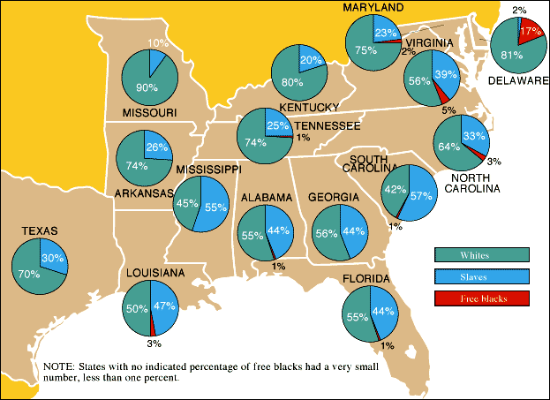

Slide 32
The Societal Pyramid
Planter aristocrats = 12,000
Lesser masters = 400,000
Yeoman farmers = 4,000,000
Free blacks = 250,000
Black slaves = 3,200,000

Slide 33
Slaves in Population

Slide 34
The “Slavocracy”
Planter aristocracy
1,700 families owning 100+ slaves
This is where the real wealth and “power” are concentrated
Lesser masters
255,000 of the 345,000 families in this grouping own less than 10 slaves.
Most own 1 or 2
Would it be logical to think there was some aspiration by the Lesser Masters to become Planters?

Slide 35
Planters in the Population

Slide 36
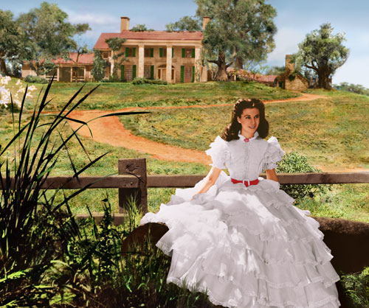

Slide 37
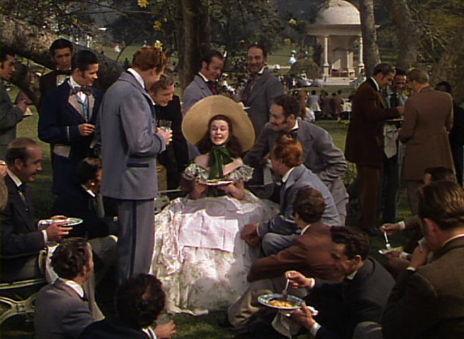

Slide 38
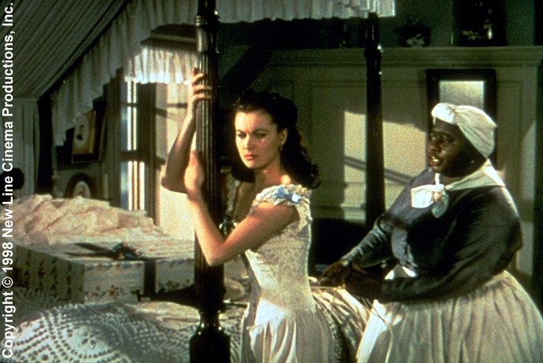

Slide 39
The Plain Folks
Subsistence farmers: "crackers”, “hillbillies”, & “clayeaters"
= 6,000,000 (3/4 of the white population) by 1860
Resent snobbery of the upper classes
are vigorous supporters of slavery
Prevailing belief in racial superiority
Comfort of outranking anyone on the hierarchy of miserable lives.
"Mountain whites" in Southern highlands
Virtually marooned in the Appalachians
Resent planters & slavery
Going to support of Unionism during the Civil War

Slide 40
African-Americans
Two main classifications
Slaves
Free Blacks
Slaves
Well over 3,000,000 on the eve of the war
Were legal in 15 states plus Washington DC
Free Blacks
Were in almost every state
Prominent communities in Charleston, Savannah, and New Orleans

Slide 41
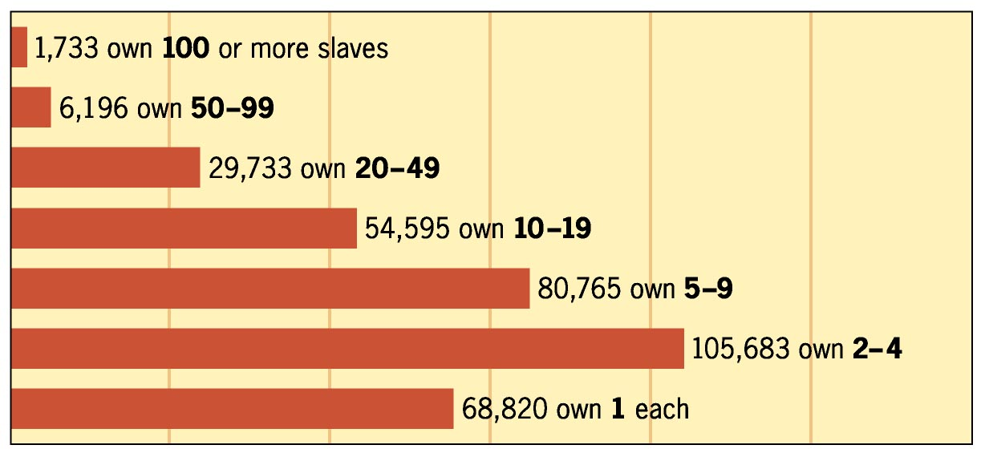
A spurious chart
1850 Census Data

Slide 43
Southern Peculiarities
Alexis de Tocqueville stated in 1830’s that the south’s distinctiveness came from slavery
The bi-racial society created a need for whites to maintain control
This “need” for control seems to have muted class conflict
After Missouri Compromise the south was a geographic, political, and economic minority

Slide 44
Conclusion
Southern society was based on a hierarchical structure with the planter aristocracy on the top, maintaining all the “power”, and flowing downward to rest on the backs of slave labor.

Slide 45
The Last Word(s)
In the final analysis, the south was and is different because the people of the south believe that it is different and distinct. This has manifested itself in the southern economy, southern social institutions, and the distinctive brand of southern politics.

Slide 46
Bibliography
“The American Pageant” – Thomas Bailey
“The Battle Cry of Freedom” – James McPherson
“The Mind of the South” – W.J. Cash
“The Civil War” – Randal & Donald
“America: A Narrative History” – George Brown Tindall (2nd Ed)
Lecture by Dr. James Hogue (UNCC) to the US History Consortium in November, 2005

